Slide 1
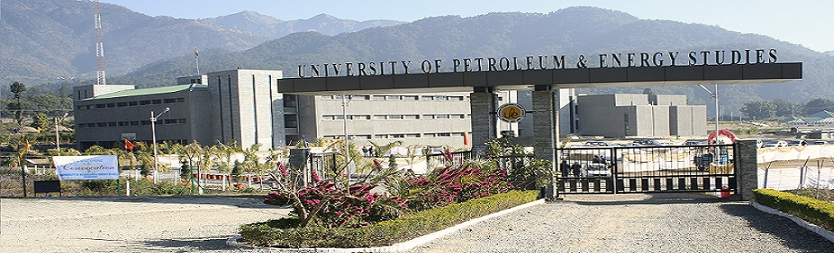
Mobile Applications Using Android
MULTIPLE SCREENS

Slide 2

ANDROID SUPPORT FOR MULTIPLE SCREENS
Android runs on many devices that support different screens sizes and densities.
Android systems take care of controlling the app screen size and their densities depending on the device it is deployed
Android app should ensure to optimize itself for different screen sizes and densities based on the device it is installed
The following terms gives the over view of API
Screen Size
Screen Density
Orientation
Resolution

Slide 3
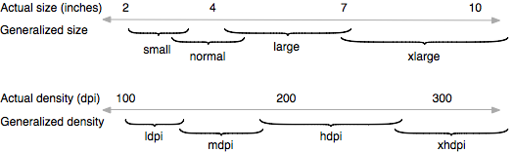
Cont.
•Screen size
–Actual physical size, measured as the screen's diagonal. For simplicity, Android groups all actual screen sizes into four generalized sizes: small, normal, large, and extra large.
•Screen density
–The quantity of pixels within a physical area of the screen; usually referred to as dpi (dots per inch). For simplicity, Android groups all actual screen densities into four generalized densities: low, medium, high, and extra high.

Slide 4
Cont….
Screen density is a ratio of resolution and display size, which can be quantified as dots per inch, or dpi. The higher the dpi, the smaller each individual pixel is, and the greater clarity.
Resolution is a measure of how many pixels a display can show at a time eg. 640x480. Density is a measure of how big each pixel is in actual units. This relates heavily to screen size eg. 640x480 on a 15' display.
When comparing one device's resolution to another, it's a straight-forward comparison: the higher the resolution, the more information you can display at a time. When comparing density: the higher the density the sharper the display will appear.
If you have high resolution and low density, then your screen will be very large. On the other hand, low resolution and high density will result in a very small screen.

Slide 5
Cont.
•Orientation
The orientation of the screen from the user's point of view. This is either landscape or portrait, meaning that the screen's aspect ratio is either wide or tall, respectively. Be aware that not only do different devices operate in different orientations by default, but the orientation can change at runtime when the user rotates the device.
•Resolution
The total number of physical pixels on a screen. When adding support for multiple screens, applications do not work directly with resolution; applications should be concerned only with screen size and density, as specified by the generalized size and density groups.

Slide 6
Cont.
Resolution independence and density independence are critical challenges
Density-independent pixel (dp)
A virtual pixel unit that you should use when defining UI layout, to express layout dimensions or position in a density-independent way.
The density-independent pixel is equivalent to one physical pixel on a 160 dpi screen, which is the baseline density assumed by the system for a "medium" density screen. At runtime, the system transparently handles any scaling of the dp units, as necessary, based on the actual density of the screen in use. The conversion of dp units to screen pixels is simple: px = dp * (dpi / 160). For example, on a 240 dpi screen, 1 dp equals 1.5 physical pixels. You should always use dp units when defining your application's UI, to ensure proper display of your UI on screens with different densities.

Slide 7
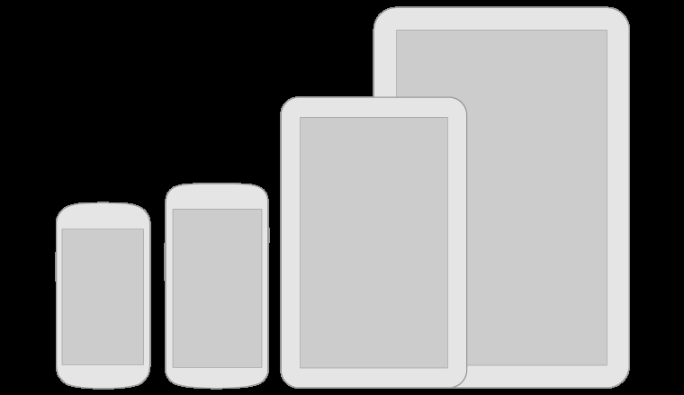
RANGE OF SCREENS SUPPORTED
•xlarge screens > 960 dp x 720 dp
•large screens > 640 dp x 480 dp
•normal screens > 470 dp x 320 dp
•small screens > 426 dp x 320 dp
Note: Support for multiple screen sizes and densities are provided from android 1.6(API level 4) onwards.
The system bar in Android 3 and above reduces app space

Slide 8
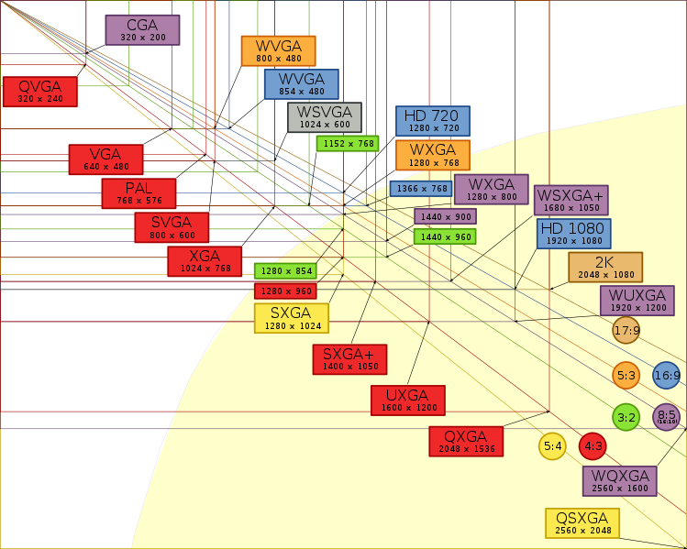
RANGE OF SCREENS SUPPORTED

Slide 9
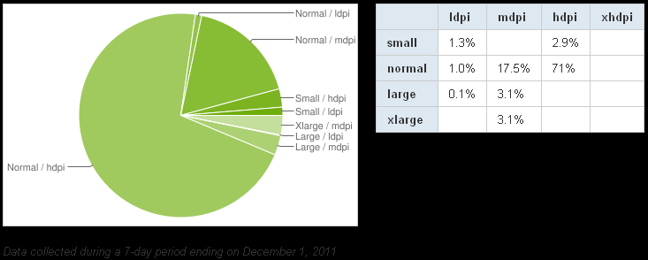
RANGE OF SCREENS SUPPORTED

Slide 10
ALTERNATIVE GRAPHICS ASSETS FOR DIFFERENT SCREEN DENSITIES
The configuration qualifiers you can use for density-specific resources are ldpi (low), mdpi (medium), hdpi (high), and xhdpi (extra high). For example, bitmaps for high-density screens should go in drawable-hdpi/.
By default, Android scales your bitmap drawables (.png, .jpg, and .gif files) and Nine-Patch drawables (.9.png files) so that they render at the appropriate physical size on each device. For example, if your application provides bitmap drawables only for the baseline, medium screen density (mdpi), then the system scales them up when on a high-density screen, and scales them down when on a low-density screen. This scaling can cause artifacts in the bitmaps. To ensure your bitmaps look their best, you should include alternative versions at different resolutions for different screen densities.

Slide 11
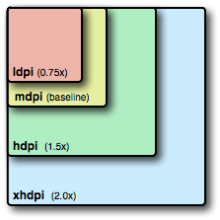
ALTERNATIVE GRAPHICS ASSETS FOR DIFFERENT SCREEN DENSITIES Cont.
To create alternative bitmap drawables for different densities, you should follow the 3:4:6:8 scaling ratio between the four generalized densities. For example, if you have a bitmap drawable that's 48x48 pixels for medium-density screen (the size for a launcher icon), all the different sizes should be:
–36x36 for low-density
–48x48 for medium-density
–72x72 for high-density
–96x96 for extra high-density

Slide 12
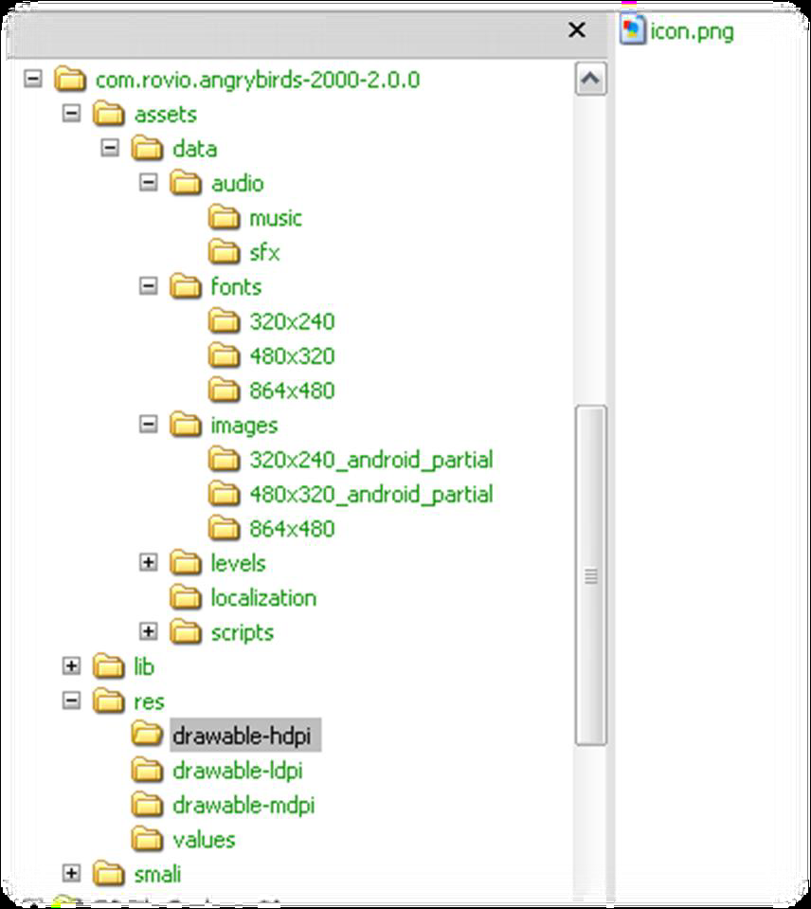
Key takeaway - public Android apps request more graphics assets
To assume dp/mdpi in conceptual design
•To design four versions graphic assets (3:4:6:8 scaling ratio) for ldpi, mdpi, hdpi and xhdpi

Slide 13

NINE-PATCH GRAPHIC ASSETS
A NinePatchDrawable graphic is a stretchable bitmap image, which Android will automatically resize to accommodate the contents of the View in which you have placed it as the background. An example use of a NinePatch is the backgrounds used by standard Android buttons — buttons must stretch to accommodate strings of various lengths. A NinePatch drawable is a standard PNG image that includes an extra 1-pixel-wide border. It must be saved with the extension .9.png, and saved into the res/drawable/ directory of your project.

Slide 14
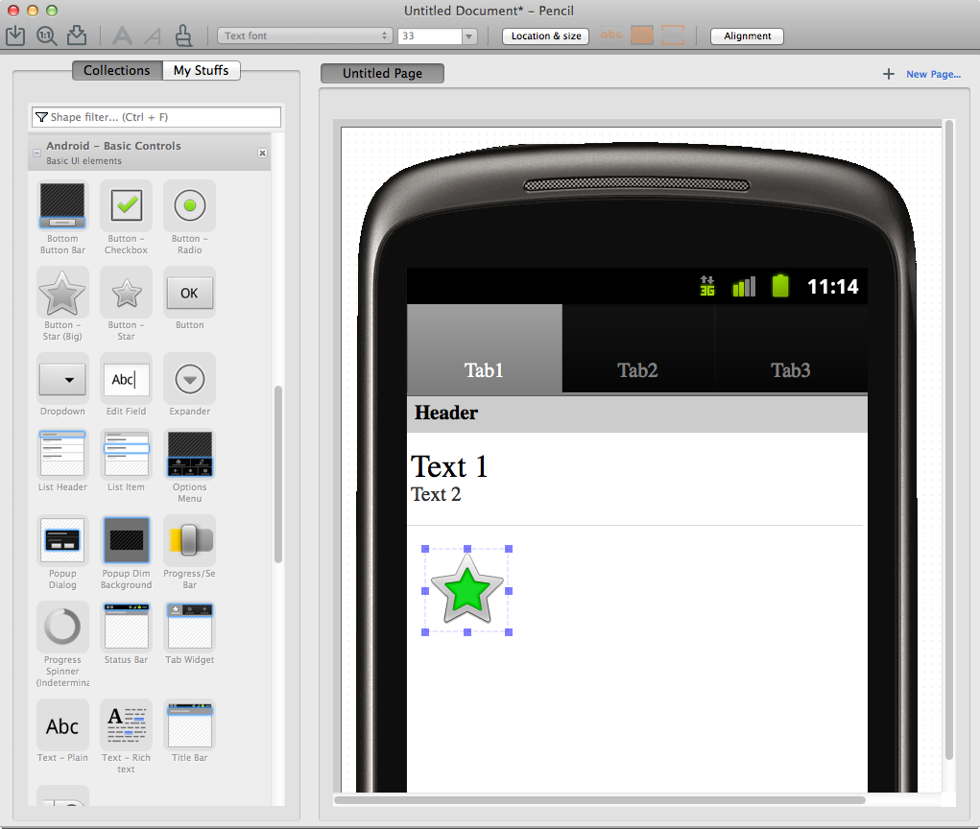
Pencil with Android Stencils is a nice UI prototyping tool
http://pencil.evolus.vn
http://code.google.com/p/android-ui-utils/

